Slide 1
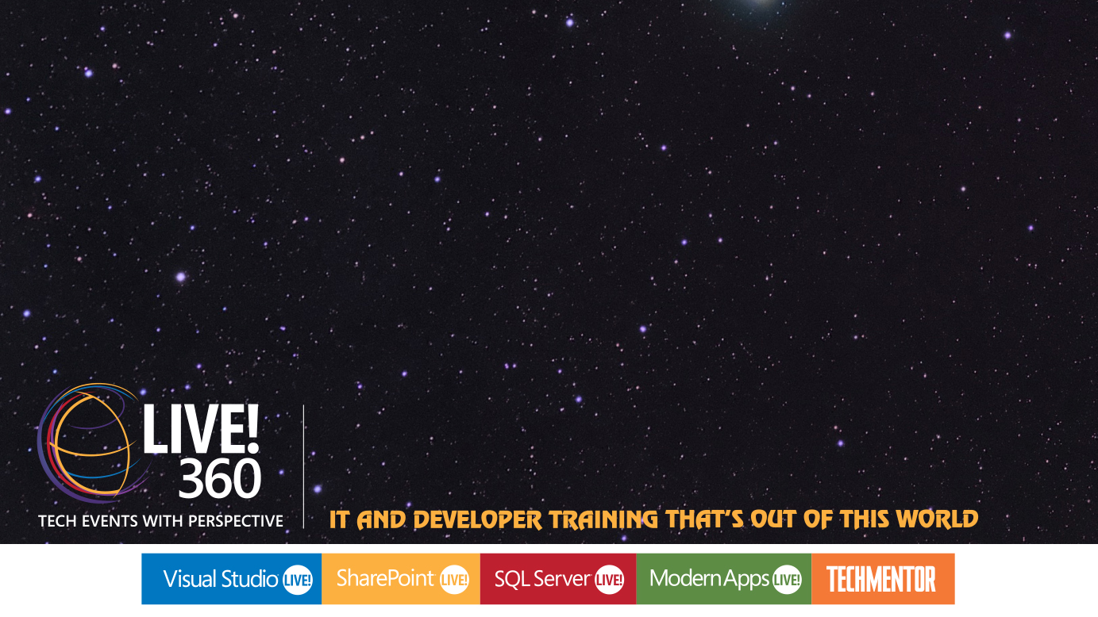
Building a Windows App
Brent Edwards
Principal Lead Consultant
Level: Intermediate

Slide 2
Brent Edwards
BrentE@magenic.com
@brentledwards
http://www.brentedwards.net
https://github.com/brentedwards

Slide 3
What We Will Cover
MVVM
Universal Apps
Azure Mobile Services
Leveraging the Business Layer
Contracts
Azure Blob Storage
Unit Testing

Slide 4
MyVote
[DEMO]

Slide 5
MVVM
Model-View-ViewModel

Slide 6
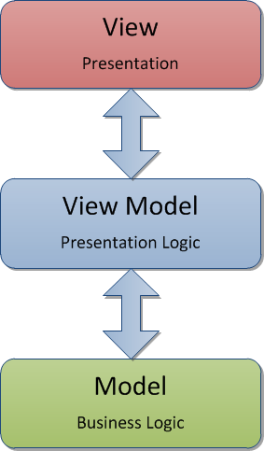
MVVM

Slide 7
Why is MVVM Cool?
Separates Presentation from Functionality
Promotes Testability
Works great with Data Binding
Easy collaboration with Designers
Makes it easy to change out the View layer!

Slide 8
MVVM Frameworks
Some frameworks support WinRT
Caliburn.Micro
MVVM Light
Both support
Navigation
Event Aggregation
Ability to bind events to view model
Caliburn.Micro has more robust binding support

Slide 9
Universal Apps
Sharing the love

Slide 10
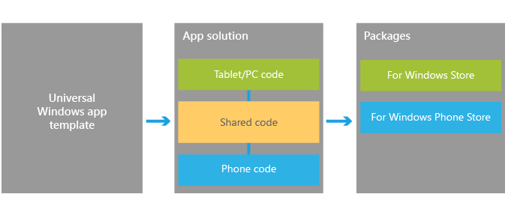
Universal Apps
What are they?
One codebase to rule them all (on Windows, anyway)
Source: https://dev.windows.com/en-us/develop/building-universal-Windows-apps

Slide 11
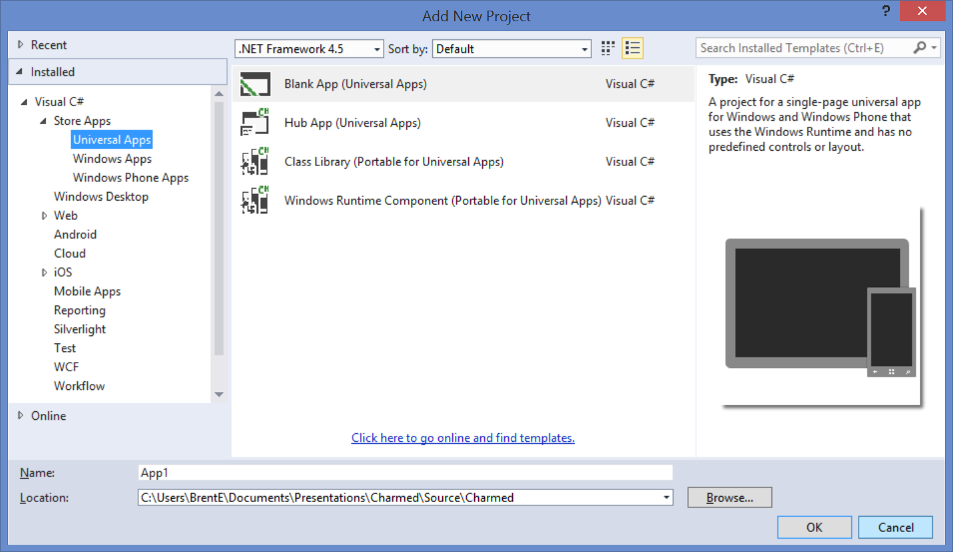
Universal Apps
Project type that came with Visual Studio 2013 Update 2

Slide 12
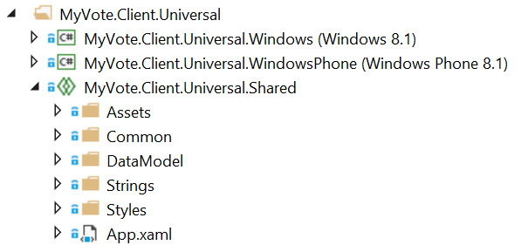
Universal Apps
Introduces concept of Universal Shared Project type
Essentially a code placeholder project
Does not compile on its own

Slide 13
Universal Shared Projects
Put common code in universal shared project
Platform-specific code in platform-specific projects
What is common?
Models
ViewModels
Converters
Services
What about views?
That depends…

Slide 14
Universal Shared Projects
A helpful Visual Studio extension
Shared Project Reference Manager
http://visualstudiogallery.msdn.microsoft.com/315c13a7-2787-4f57-bdf7-adae6ed54450

Slide 15
Navigation

Slide 16
Navigation
Much simpler with Universal Apps!
Approach is now unified
View-driven with 1 optional parameter
Parameter can be anything
2 Problems
Logic for navigation is generally in ViewModel
ViewModels have to know about Views?!?!
Not easily mocked in unit testing

Slide 17
Navigation
Solution
Provide abstraction layer for view model driven navigation

Slide 18
Navigation
[DEMO]

Slide 19
Azure mobile services

Slide 20
Azure Mobile Services
Primary Features
Authentication
Push Notifications

Slide 21
Authentication
oAuth done easy
4 Auth Options
Twitter
Facebook
Microsoft
Google
Biggest Drawback
Users have to remember which option they chose

Slide 22
Authentication
Things to consider
Is your app open to anyone?
Does your app need domain authentication?
If so, Azure Mobile Services is probably not the best option for auth

Slide 23
Push Notifications
Deliver info to your users through notifications
Tile
Badge
Toast
Things to consider
How can your Tile be more Live?
What info to show in Toasts?

Slide 24
Azure Mobile Services
[DEMO]

Slide 25
Leveraging the business layer

Slide 26
Leveraging the Business Layer
A little planning goes a long way
The same code can be used on
Server (.NET)
Client (Windows / Windows Phone)
N-Tier business layers can leverage
Compiler directives
Different project types
Universal Shared Projects

Slide 27
Leveraging the business layer
[DEMO]

Slide 28
contracts
Windows 8.1

Slide 29
Contracts
What are they?
Agreements between one or more apps
Provide consistency across all apps

Slide 30
Examples of Contracts
Search
Share
Settings
Play To
File Picker
Cached File Updater

Slide 31
Contracts
Contracts You SHOULD Leverage
Search
Share
Settings
You HAVE to use this one with Internet access
Why?
Always available via Charms menu

Slide 32

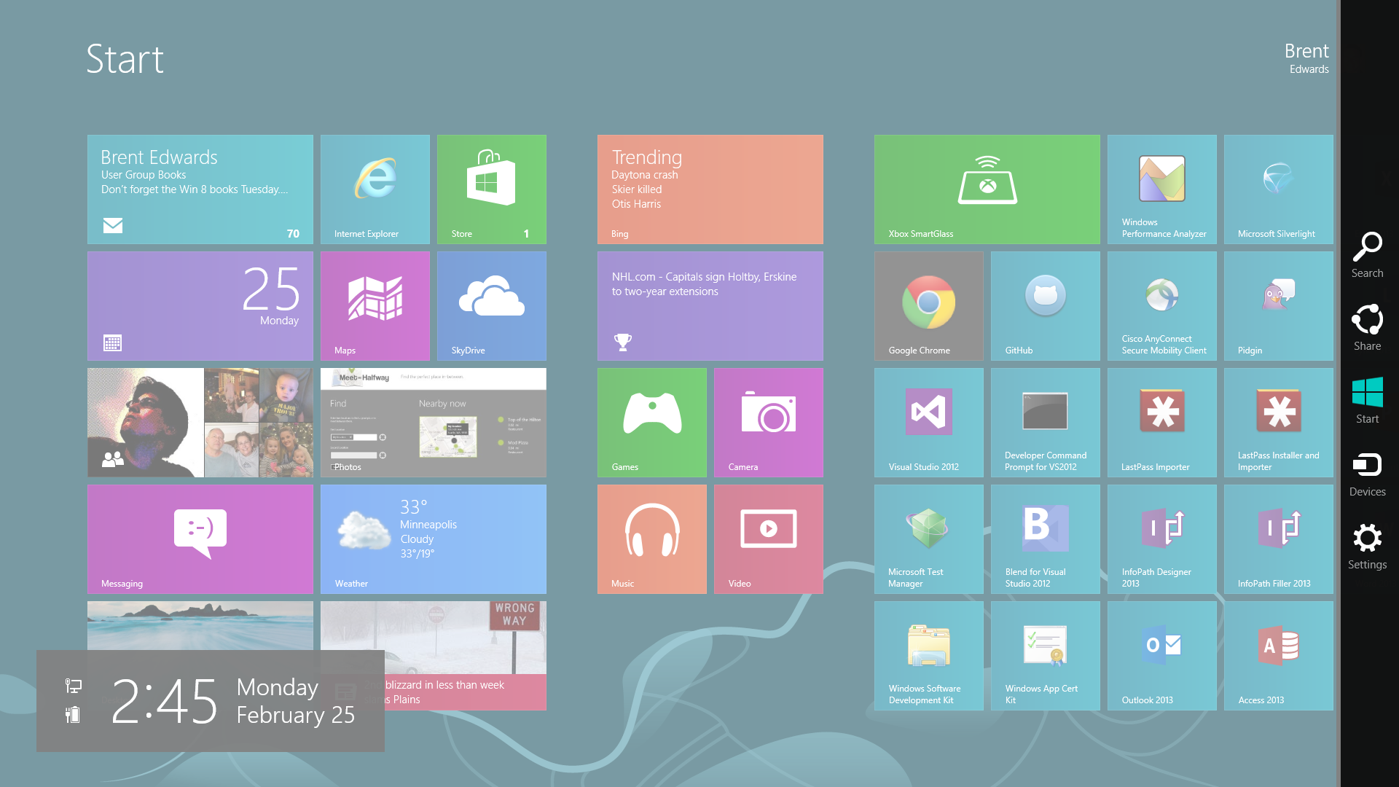
Charms Menu

Slide 33
Search
Search your app from anywhere in the OS
Things to consider
What can be searched?
Search complexity?
Parsing?
How to display?

Slide 34
Search
[DEMO]

Slide 35
Share
Share content from your app
Can be context specific
Content can be shared in many formats
Different apps support different formats
Support as many formats as possible
Fire and forget
One format: Custom URIs

Slide 36
Share
Sharing is supported in Windows Phone 8.1
No charms bar, so it has to be manually added

Slide 37
share
[DEMO]

Slide 38
Settings
Change settings in your app
Any app-wide settings should go here
Users will be conditioned to use this

Slide 39
Settings
Things to consider
What app-wide settings will you need?
How can they be simplified?
How will changing them affect the UI?
Changes should be reflected immediately
Will you use the Internet?
If so, you MUST provide a privacy policy

Slide 40
settings
[DEMO]

Slide 41
Azure blob storage

Slide 42
Azure Blob Storage
A Couple of Options
Nuget Package
Windows Azure Storage
REST API

Slide 43
Windows Azure Storage Library
Nuget Package
Gives access to containers and blobs
Can use credentials directly
Or, better yet…

Slide 44
Storage Access Security (SAS)
What is it?
Temporary key
Has built-in expiration
SAS keeps credentials out of client
Recommend generating on server

Slide 45
REST API
Provides all Blob Storage functionality
Create containers
Upload blobs
Can use credentials directly
Better yet, use SAS

Slide 46
Azure blob storage
[DEMO]

Slide 47
Unit testing

Slide 48
Unit Testing
Almost the same as .NET
Runs right alongside .NET tests in MSTest
Biggest Difference?
No Reflection.Emit namespace
Which means?
No mocking frameworks!
Have to hand roll all mocks

Slide 49
Unit testing
[DEMO]

Slide 50
What We Covered
MVVM
Universal Apps
Azure Mobile Services
Leveraging the Business Layer
Contracts
Azure Blob Storage
Unit Testing

Slide 51
Useful Links
Windows Azure
http://www.windowsazure.com/en-us/
Windows Dev Center
http://www.windowsstore.com/

Slide 52
Questions?

Slide 53
Brent Edwards
BrentE@magenic.com
@brentledwards
http://www.brentedwards.net
https://github.com/brentedwards

